Slide 1
Bike Demand Forecasting
Machine learning model for predicting bike-sharing demand using time series analysis and seasonal decomposition
Nitya Devaraj

Slide 2
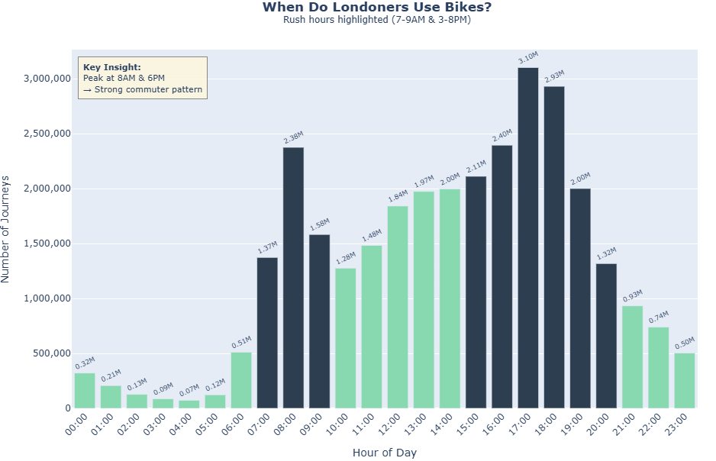
Data overview (2019-2021)
EDA Outcomes
  Infrastructure: 17,766 unique bikes
  Scale: ~10 million journeys per year
  Consistent Demand: Only 11% variation between busiest and quietest days
  Short-Term Usage: 87% of journeys ≤ 30 minutes
  Post-COVID Growth: 5.5% increase in journeys per day
  Commuter Pattern: Peaks at 7–9am and 4–8pm
  Operational Insight: Bikes need redistribution before 7am; low overnight usage = maintenance window
Data science use cases
  Demand Forecasting: Predict hourly/daily demand per station for fleet sizing, pricing, etc.
  Bike Redistribution Optimization: Predict where bikes accumulate/deplete to improve availability and reduce costs
  Customer Segmentation: Identify user types (commuter, leisure, tourist) for targeted marketing and products
Notes:
EDA approach
Scrape relevant data (2019-22 usage stats) from TfL website
Read and combine all the data asynchronously (31M records) into a parquet file so can be reused
Remove outliers based on threshold for duration (only considered journeys less than 24h to focus on short term rentals)

Slide 3
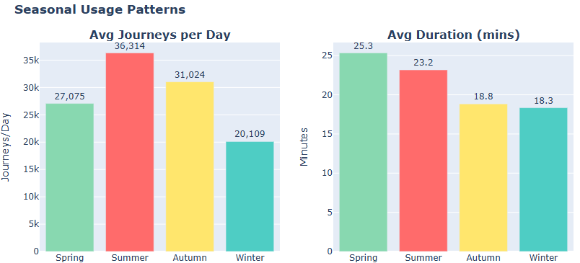
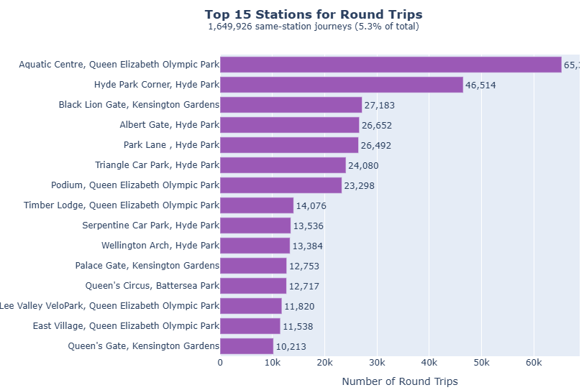
Usage pattern- customer behaviour and seasonality
Seasonal demand patterns
  Summer: highest demand (scale fleet +20%)
  Spring: longest ride duration (leisure behaviour)
  Autumn/Winter: shorter commuter dominated rides
Customer segments
  Two distinct user types with different needs
  Commuters
  Leisure users: Round trip journeys at parks/tourist areas
  5.3% of all journeys are same station round trips
  Hotspots: Hyde Park, Kensington Gardens, Olympic Park
Notes:
This is usage as well as customer patterns/classification

Slide 4
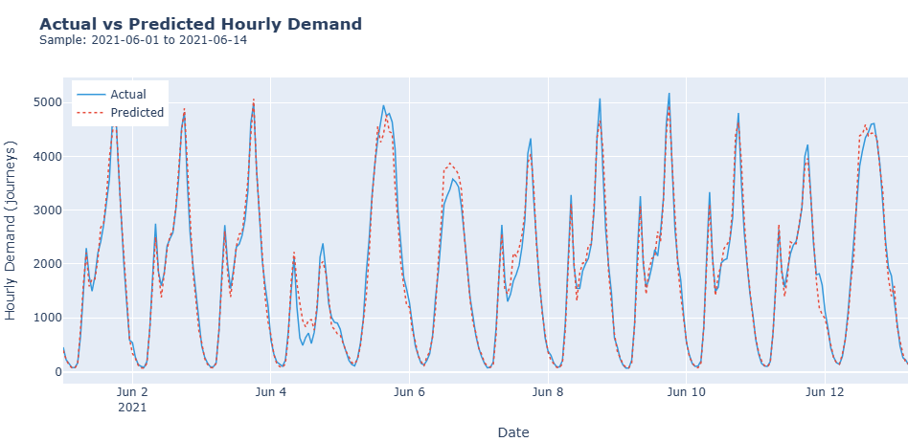
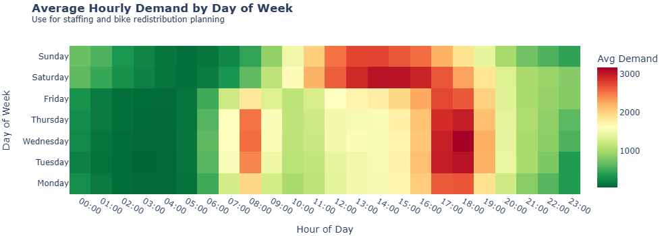
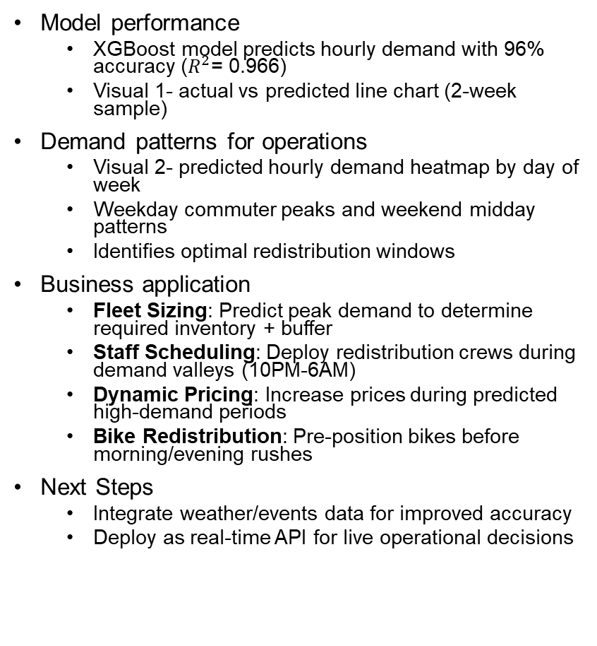
Demand Forecasting Model
Model performance
  XGBoost model predicts hourly demand with 96% accuracy ($R^{2}$= 0.966)
  Visual 1- actual vs predicted line chart (2-week sample)
Demand patterns for operations
  Visual 2- predicted hourly demand heatmap by day of week
  Weekday commuter peaks and weekend midday patterns
  Identifies optimal redistribution windows
Business application
  Fleet Sizing: Predict peak demand to determine required inventory + buffer
  Staff Scheduling: Deploy redistribution crews during demand valleys (10PM-6AM)
  Dynamic Pricing: Increase prices during predicted high-demand periods
  Bike Redistribution: Pre-position bikes before morning/evening rushes
Next Steps
  Integrate weather/events data for improved accuracy
  Deploy as real-time API for live operational decisions

Slide 5
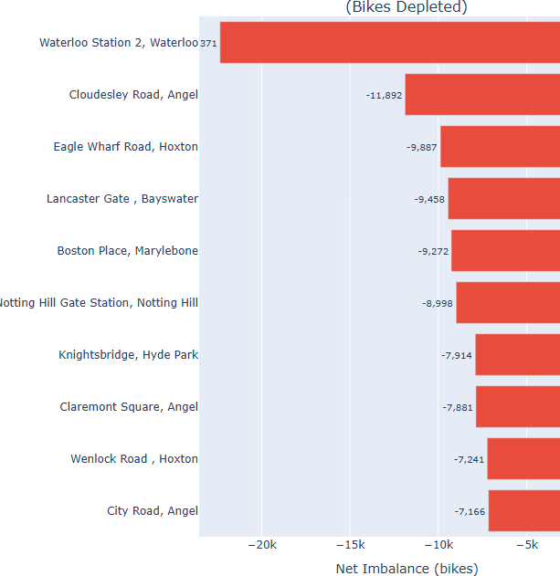
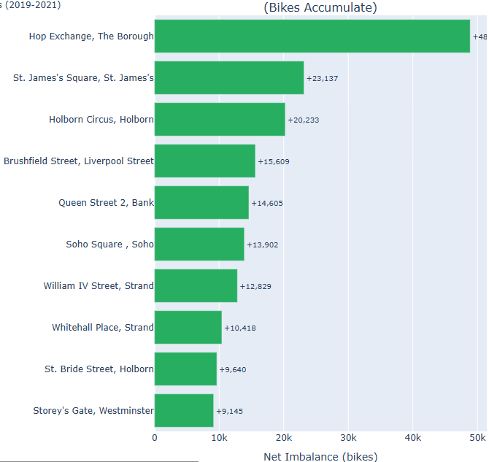
Recommendations
1. Optimise bike redistribution
  Strategy: Combine station imbalance data + hourly demand forecasts
  Actions:
  Pre-position bikes at source stations before 7AM rush
  Deploy collection crews at sink stations overnight 10PM-6AM Prioritise top 10 imbalanced stations (80% of redistribution need)
  Visual: Station imbalance bar chart (sources vs sinks)
  Impact: ↓ operational costs, ↑ bike availability, ↑ customer satisfaction
2. Customer-Segmented Pricing Strategy
  Strategy: Two products for two distinct user types
  Actions:
  Commuter Pass: Flat monthly fee for unlimited 30-min rides (87% of journeys qualify)
    Target: Weekday 7-9am, 4-8pm users
  Leisure Premium: Higher per-ride pricing, round-trip/park stations
    Target: Weekend users, tourists, round-trip journeys (longer duration = higher revenue, see slide 3)
  Dynamic Pricing: Surge pricing during predicted peak hours (6-8PM weekdays)
  Impact: ↑ revenue per journey, ↑ customer retention (locked-in commuters), optimised capacity
Notes:
Problem: Station imbalance causes availability issues & operational inefficiency
Problem: Two distinct customer types with different needs & willingness to pay

